Slide 1

$$ Online Stock Forecasting $$
Group-13 :
Milin Thiru
Bhavya Rakesh Vidur

Slide 2
Individual Group Member’s Contribution Breakdown
For this project, all group members have contributing equally.
Phase Members
Project Meetings All Members
Data Collection All Members
UI development Milin, Vidur
Designing Web Services and Database Rakesh, Thiru
Designing Prediction Strategies Thiru, Bhavya
Integration and Testing All Members
Report and Presentation All Members

Slide 3
Project Overview
Our Project Aim
Developing a web application which provides access to users, a reliable prediction of stock values of companies they are interested in.
Using Technical analysis
The technical analysis would based on the analysis if historical market data, we would get using Yahoo Finance APIs. We are collecting both the historical and real time stock data.
Development Environment
Java for developing the web services.
Amazon AWS for hosting web services.
PostgreSQL for database.
JSP , HTML, AJAX, JS, CSS , Twitter-Bootstrap theme for UI development

Slide 4
Project Overview
Our project mainly focuses on three aspects:
Real time data feed
We have used real time data that is collected from Yahoo Finance API. So the prediction is based on real time data feeding and long term prediction is based on historical data, thus making it a realistic prediction advisory.
Prediction Strategies and Web Services
We are providing prediction for both long term (next 10 days) and short term (next 5 values with interval for 30 sec ).
These algorithms run as a back-end task and compute the prediction values for the various stocks completely abstracted from the User.
Easy Access to Web Interface
The web application would be offering various functionalities to the end users like
Getting valuable information about the stocks.
Some tips on how to deal with their current stocks etc.

Slide 5
High-level Block Diagram
Web Services
Yahoo Finance APIs
Application Interface
Client User Interface
WEB SERVER
Apache
Tomcat
8
User
on
Amazon AWS
Database Interface
Google Trends APIs
DataBase

Slide 6


Why Stock Prediction ?
It’s all about $$$ ..
Why do anyone invest in stock markets ?
$. To become a part owner of the business
$. To receive profits which are named as Dividends.
Stocks are at a relatively high potential in terms of
returns when compared to mutual funds and bonds.
The potential comes at a price of high risk of losing
some or the total investments at times.
Hence, investors are interested in stock predictions.

Slide 7
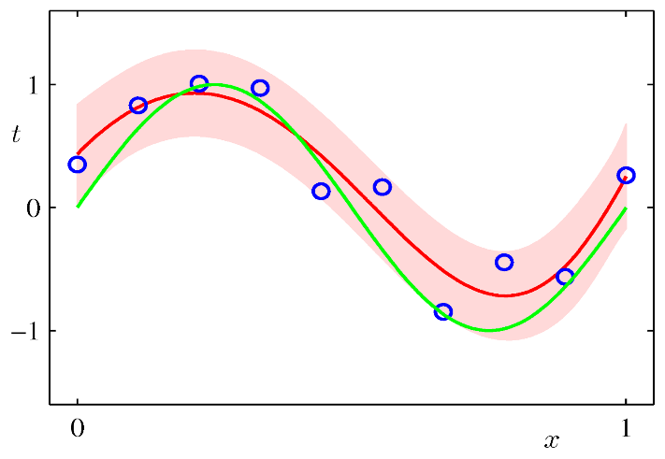
Short term Prediction Strategy - Bayesian
About Bayesian….
Curve fitting is the process of constructing a curve, or mathematical function, that has the best fit to a series of data points, possibly subject to constraints
Previous data is used to fit the curve and can be used to predict future value.
Bayesian linear regression is a prediction with the probability of random variable
To predict intra-day stock prices
Our Duration
Prediction window: Next 5 Values

Slide 8
Long term Prediction Strategy – AI & Machine Learning
Artificial Intelligence is used as a key tool to predict the stocks based on long-term periods.
Machine Learning Technique: Support Vector Machine
Machine Learning Technique: Artificial Neural Networks

Slide 9
Decision Making ! – Our Recommendation Policy
Ultimately, the stock analysis is to make a decision whether to buy, sell or hold a stock.
For Long Term Prediction and Recommendation Strategy
Raw Stock data
Decision ?
Buy / Sell / Hold
ANN
SVM
Our
Recommendation
Policy

Slide 10
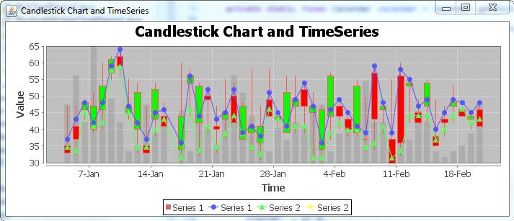
Consulting from Patterns
We are using patterns to reduce the uncertainty of forecast.
Cup and Handle Pattern
Ascending Triangle
Head and Shoulders
Descending Triangle
BUY
SELL
HOLD

Slide 11
Web Services
1. The real time data API (GET)
http://machine_name/com.stockprediction/rest/services/realtimedata?symbol =symbol
This API gives the real time data (time, price and volume)of the stock mentioned in the symbol
argument of the query string for the present day from 9AM to the current time.
2. The stock details API (GET)
http://machine_name/com.stockprediction/rest/services/stockdetails?symbol =symbol
This API gives the details of the stock mentioned in the symbol argument of the query string.
Details include year low, year average, latest price, latest volume and ten day high price.
3. List of stocks’ details (GET)
http://machine_name/com.stockprediction/rest/services/ list
This API gives the year low, year average, latest price, latest valume and ten day high price for all
the stocks in our database.
4. List of stocks whose average is lesser than lowest of stock (GET)
http://machine_name/com.stockprediction/rest/services/ listavglowthan?symbol=symbol
This API gives the list of stocks whose average price is less than the lowest of the stock metioned
in the query string by the symbol.

Slide 12
Web Services
6. Short term prediction (GET)
http://machine_name/com.stockprediction/rest/services/ shortterm?symbol=symbol
This API gives the short term prediction for the next 5 minutes for the stock mentioned by
symbol in the query string.
7. Long term prediction (GET)
http://machine_name/com.stockprediction/rest/services/ longterm?symbol=symbol
This API gives the long term prediction for the next 10 days for the stock mentioned by symbol in
the query string.
8. User Registration (POST)
http://machine_name/com.stockprediction/rest/services/ userregistration
This API accepts details of the user - first name, last name, company, position, phone, email,
password. It creates a record in the database.
9. User login (POST)
http://machine_name/com.stockprediction/rest/services/ userlogin
This API accepts the email and the password of the user. If the password matches with the
record in the database, it returns a JSON object with authenticated attribute as true along with
the details of the user.

